Slide 1
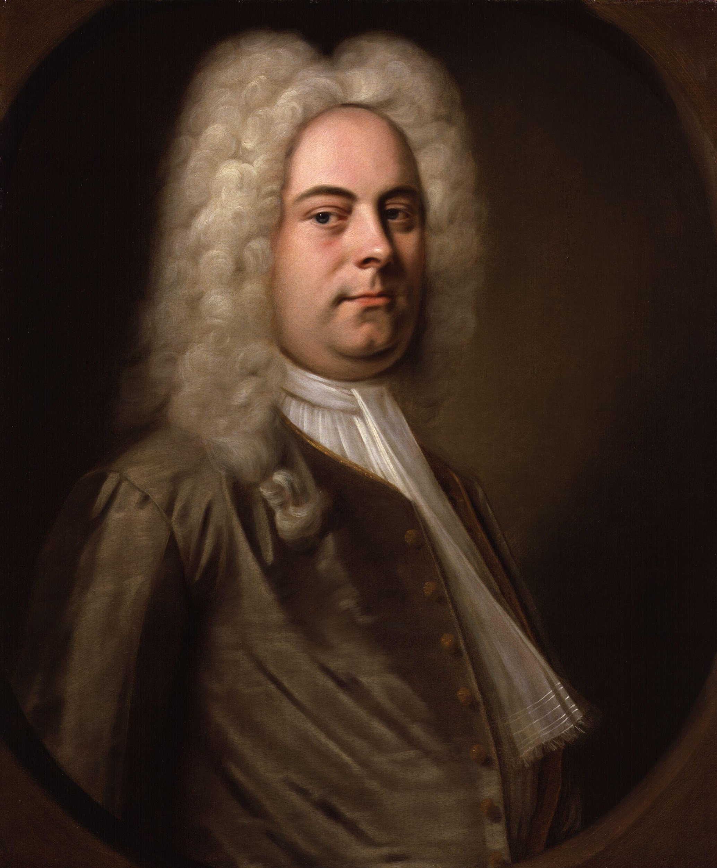
Composer Project
George Frideric Handel (1685-1759)

Slide 2
Early Music Education
George Frideric Handel is known for being the most famous composer in Europe. Growing up, his father had demanded that he pursued a trade in laws. Though this was what his father’s wanted for him, Handel, slowly grew toward the interest in music. At age eighteen, Handel pursued his music education in Italy. He was educated at University of Halle (Editors, 2020). After ten years in Italy, Handel returned to Germany and accepted a music director position for the Elector of Hanover. (Wright, Listening to Western Music, Chapter 9).

Slide 3
Influencing Factors Leading To Music Profession
Handel’s father was not supportive in his passion in music. His mother, however, supported and encouraged him. With her encouragement, Handel took advantage of this. At a young age, Handel was given the opportunity to played organ for the Ducks Court in Weissenfels. There, Handel met composer and organist Frederic Wilhelm Zachow. Zahow wanted Handel to be his pupil after see how talented he was. Handel mastered composing for the organ, the oboe, and violin by the age of ten. From the age of eleven to seventeen, Handel composed church cantatas and chamber music. Though Handel did study into law as his father insistenced, eventually, at age eighteen, Handel completely committed to music. He accepted a violinist’s role at Hamburg Opera’s Goose Market Theater in which his earned his income by teaching music lessons. (Editors, 2020)

Slide 4
Last Contribution Made to Music
From 1732 and continuing for two decades, Handel wrote nearly twenty oratorios. This all took place a decade early before his death in 1759. His last contribution made to music was in the composition of Messiah. It was first performed in Dublin, Ireland as part of a charity benefit 1742. By 1750, he made minor alterations and again performed it in Covent Garden Theater, London. This time it was performed in the chapel of the Foundling Hospital, an orphanage in London. This generated great profit for charity. (Wright, Listening to Western Music, Chapter 9).

Slide 5
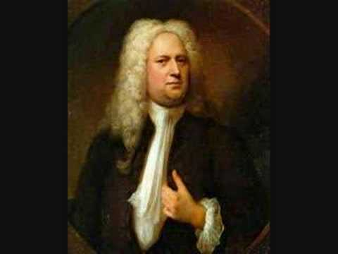
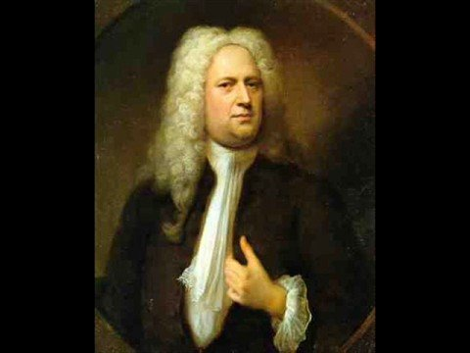
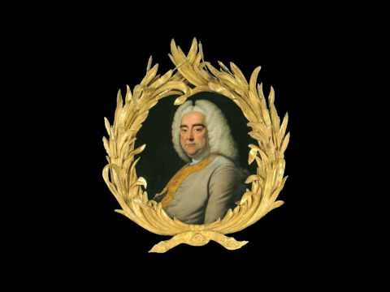
Examples Of Handel’s Work
Music for the Royal Fireworks (1749)
Water Music (1717)
Messiah (1741)

Slide 6
Fun Facts About George Frideric Handel
Handel was born in February 23, 1685. It’s the same year as Johann Sebastian Bach. Since Handel’s father was not a big fan in his musical interest, Handel had to sneak into the attic to cultivate his skill often, and in secret. By early 1700, after believing that he would be successful in his trade, Handel formed an opera company, the Royal Academy of Music, and served as composer, director and producer. However, by 1728, the company went bankrupt. This however did not stop him from writing operas, which continued to 1740. (Wright, Listening to Western Music, Chapter 9).

Slide 7
More Fun Facts About George Frideric Handel
During Handel’s performance of Messiah “Hallelujah”, King George II rose to his feet in admiration, and therefore establishing the tradition of the audience standing for the “Hallelujah” chorus. Handel is without a doubt the finest composer for chorus who ever lived. At Handel death, he left an estate of E20,000 (equivalent of $5.5 million today). More than 3,000 people attend his funeral in Westminster Abbey on April 20, 1759. (Wright, Listening to Western Music, Chapter 9).

Slide 8
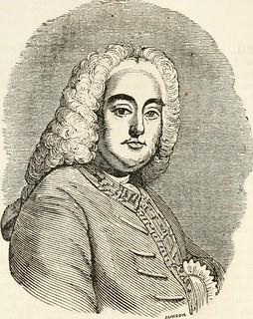
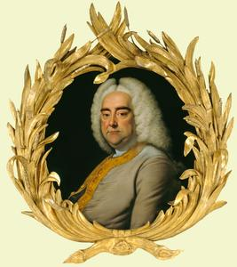
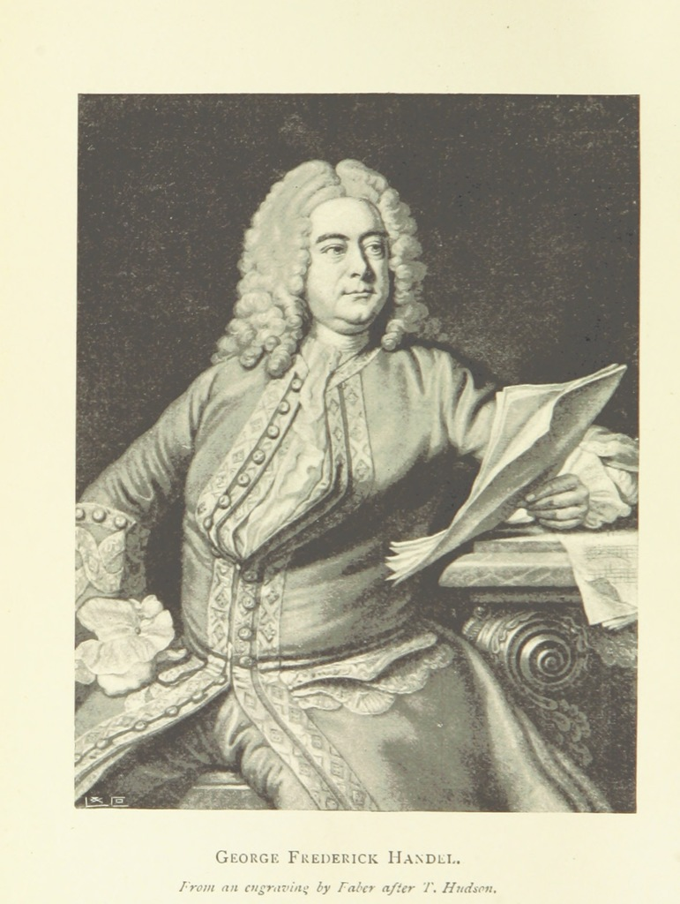
Pictures of Composer

Slide 9
Works Cited:
Craig Wright, Listening to Western Music (Eighth Edition), Yale University, 2020.
Editors, B. (2021, March 25). George Frideric Handel Biography. Retrieved from The Biography.com website: https://www.biography.com/musician/george-handel

